Slide 1
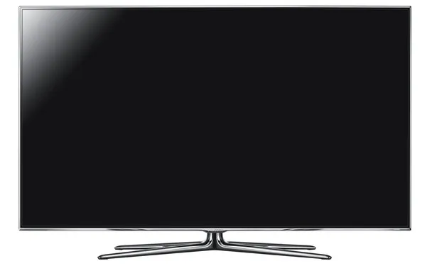
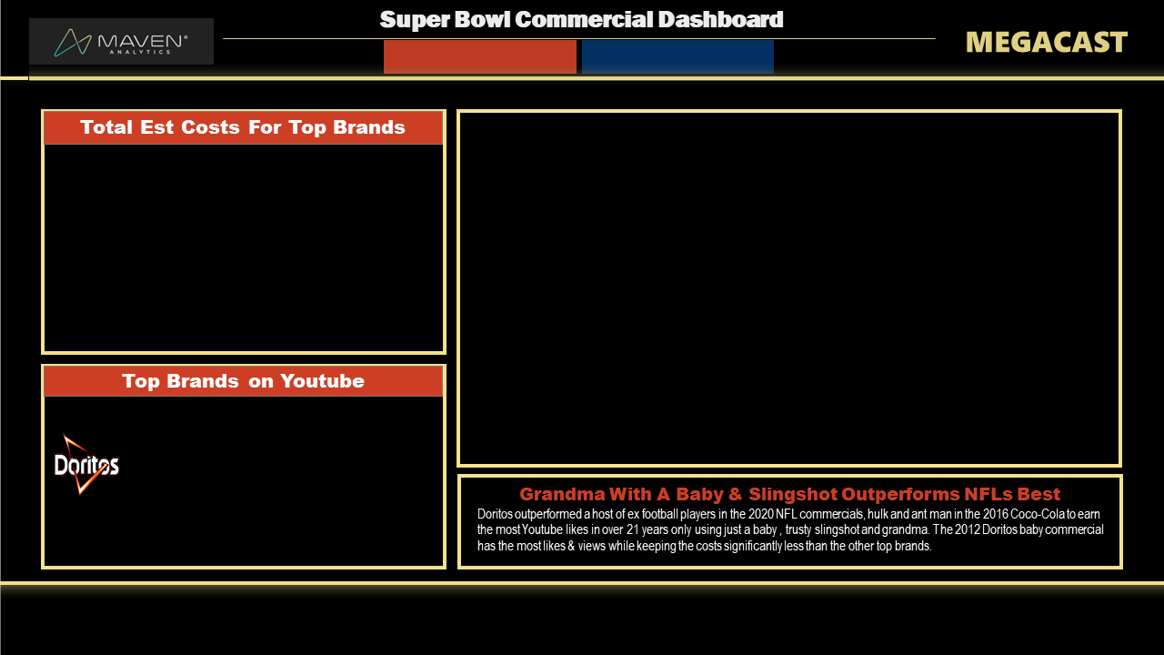

Slide 2

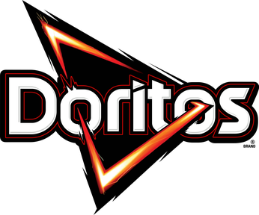
Super Bowl Commercial Dashboard
MEGACAST
Total Est Costs For Top Brands
Top Brands on Youtube
Grandma With A Baby & Slingshot Outperforms NFLs Best
Doritos outperformed a host of ex football players in the 2020 NFL commercials, hulk and ant man in the 2016 Coco-Cola to earn the most Youtube likes in over 21 years only using just a baby , trusty slingshot and grandma. The 2012 Doritos baby commercial has the most likes & views while keeping the costs significantly less than the other top brands.

